Slide 1
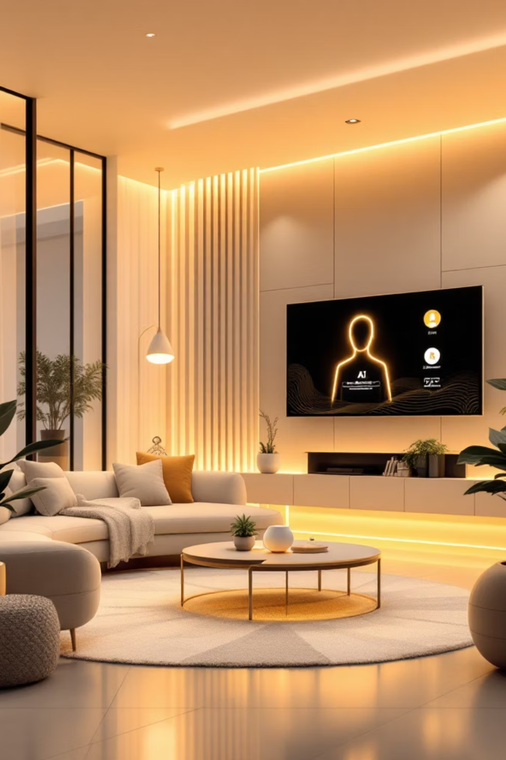
SmartSpeak: Voice-Controlled AI Assistant Using MERN Stack
Empowering hands-free interaction with intelligent technology.
Rani Kumari (202410116100163)
Riya Gaur (202410116100171)
Riya (202410116100170)
Sagar Gupta(202410116100174)

Slide 2

Project Overview: The Future of Interaction
SmartSpeak represents a leap in conversational AI, offering an AI-powered voice assistant designed for effortless, hands-free interaction. Imagine controlling your digital world with just your voice.
Our robust foundation utilizes the MERN stack (MongoDB, Express.js, React, Node.js), providing a full-stack web application capable of high performance and scalability.
The core functionality focuses on understanding and responding to natural voice commands, executing tasks such as information retrieval, setting reminders, and managing smart home devices, all through an intuitive voice interface.

Slide 3
Objectives & Scope: Building Intelligent Interaction
1
2
3
Responsive Voice Interface
Natural Language Understanding (NLU)
Seamless Backend Integration
Develop a highly responsive voice interface with industry-leading speech recognition accuracy, ensuring seamless and natural user interaction.
Ensure seamless integration with robust backend services and secure databases, enabling reliable data exchange and efficient task execution.
Implement advanced natural language understanding capabilities to interpret diverse user commands, moving beyond keyword recognition to true intent understanding.
Key Scope Areas:
Voice Command Processing: From spoken word to actionable response.
User Personalization: Authentication and custom settings for a tailored experience.
Smart Home Control: Basic management of connected devices.
Information Queries: Quick access to relevant data.

Slide 4

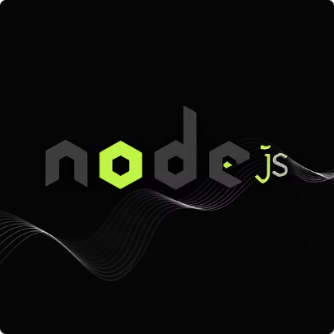


Methodology: The MERN Stack Powerhouse
Frontend: React
Backend: Node.js & Express.js
Database: MongoDB
Voice Processing
Leveraging React for a dynamic and intuitive user interface, ensuring a fluid experience for voice input handling and visual feedback.
MongoDB provides a flexible, scalable database solution for storing user data, preferences, and comprehensive command history.
Utilizing Node.js and Express.js to manage efficient API requests and business logic, forming the backbone of SmartSpeak's operations.
Integration with the Web Speech API or leading third-party services for accurate speech-to-text and natural text-to-speech capabilities.
Agile development principles will guide our workflow, incorporating iterative testing and continuous user feedback for optimal results.

Slide 5

Requirements & Timeline: Paving the Way to Launch
Project Timeline:
Key Requirements:
MERN Stack Environment: A fully configured development setup is essential.
Speech APIs: Access to robust speech recognition and synthesis APIs.
Testing Devices: Devices equipped with high-quality microphones and speakers for accurate testing.
Cloud Infrastructure: Scalable cloud services for deployment and performance.
Plan
Test
Week 1–2: Requirements & design
Week 6: Integration and testing
Develop
Launch
Week 3–5: Frontend & backend
Week 7: Deployment & training
This structured timeline ensures a focused approach from initial concept to final deployment.

Slide 6

Expected Outcomes: Transforming Interaction
Functional AI Assistant Prototype
Enhanced User Experience
Scalable Architecture
Significantly improved user experience through intuitive and natural voice interaction, making technology more accessible.
Establishment of a scalable and modular architecture, enabling seamless future feature expansion and integration.
Delivery of a robust, functional voice-controlled AI assistant prototype, ready for user trials and further development.
Foundation for Innovation
Laying the groundwork for advanced smart home automation and innovative productivity tools, expanding SmartSpeak's potential.

